Slide 1
GitHub 2 collaboration

Slide 2
GitHub makes it easy to collaborate on a code project (I hope)
Some typical group workflows are described here:
https://uoftcoders.github.io/studyGroup/lessons/git/collaboration/lesson/ (*)
and directions specific to using GitHub Desktop (the app you have installed, let's call it GHD) are here:
https://help.github.com/en/desktop/contributing-to-projects (**)
We will use a collaboration style involving cloning and forking, as described in Exercise 4 of (*), but using GHD.

Slide 3
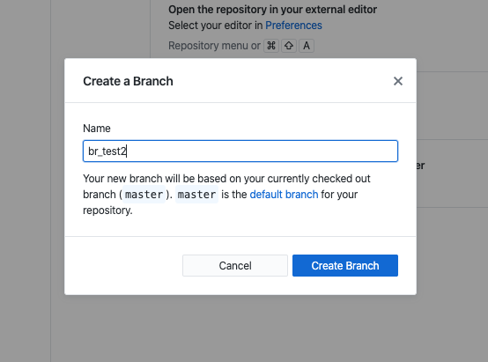
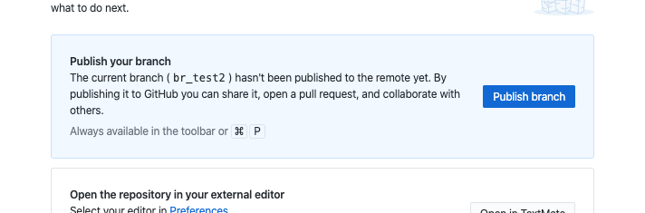
A code project has a Leader and Collaborators
Leader makes master repo and pushes it to their GitHub account, and then tells Collaborators what its URL is
Collaborators clones the repo to their laptop
Collaborator makes a new "branch" with a descriptive name related to what they are doing (e.g. fixing_plots)
Go ahead and publish it - but because you aren't the owner it will ask you to make a "fork" - go ahead and do that.

Slide 4
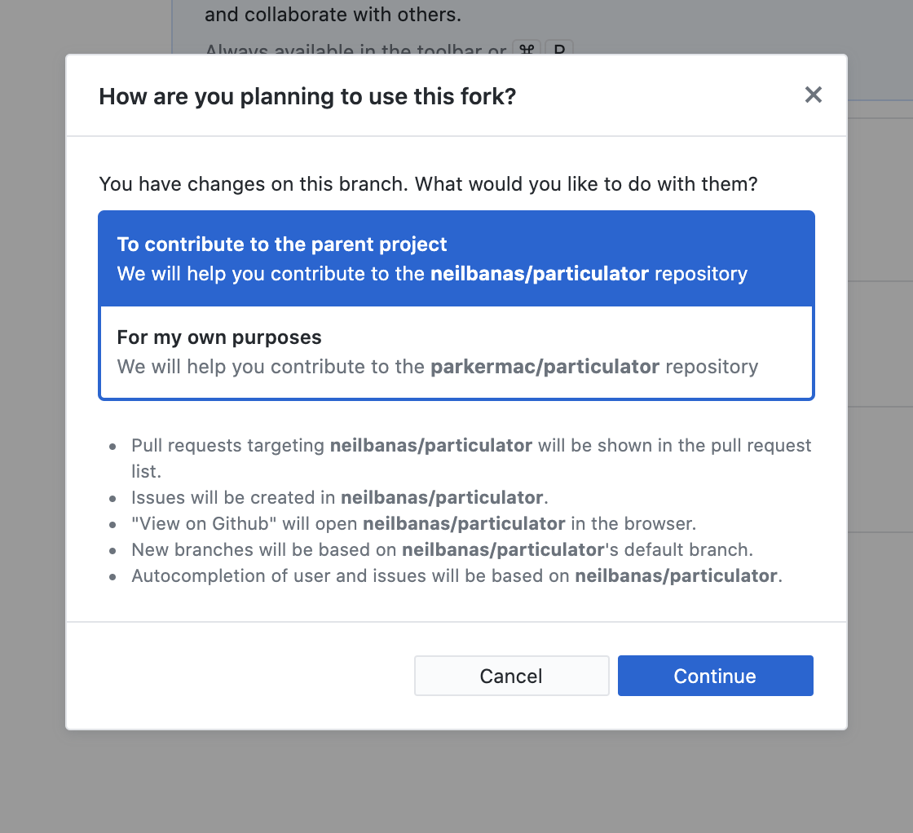
UPDATE 2020.10.01
When I walked through this process this week for my own collaborative research, I noticed that GitHub Desktop asked a new question.
I chose “To contribute to the parent project” which is my intent in this case.
PM

Slide 5
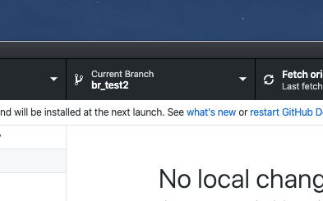
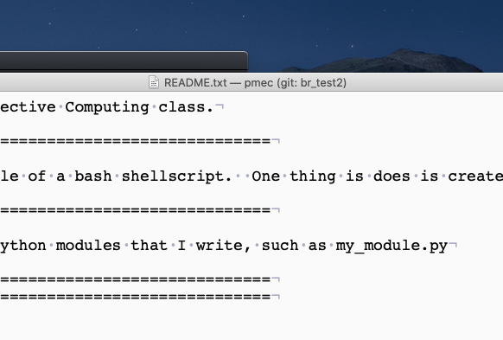
Then...
GHD
Collaborator (with GHD open and looking at the branch, not master, so that their text editor is editing the branch) edits the file.
Does this also mean that ipython is using that branch? Yes it does on my mac - but I wonder how this will work on the Windows-Ubuntu version??
Test it by making a change in the code in the branch and then switching in GHD between the branch and master, and make sure the selected one executes in ipython.
I'm still a little confused about this...
TextMate

Slide 6
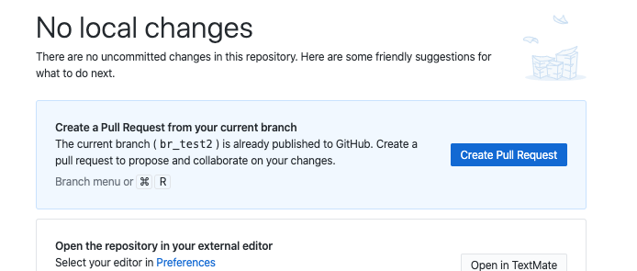
Then...
Collaborator saves changes to their branch, pushes the changes to GitHub, and sends a "Pull Request"
The Leader should get an email about this - mine showed up in my Forums tab in Gmail.

Slide 7
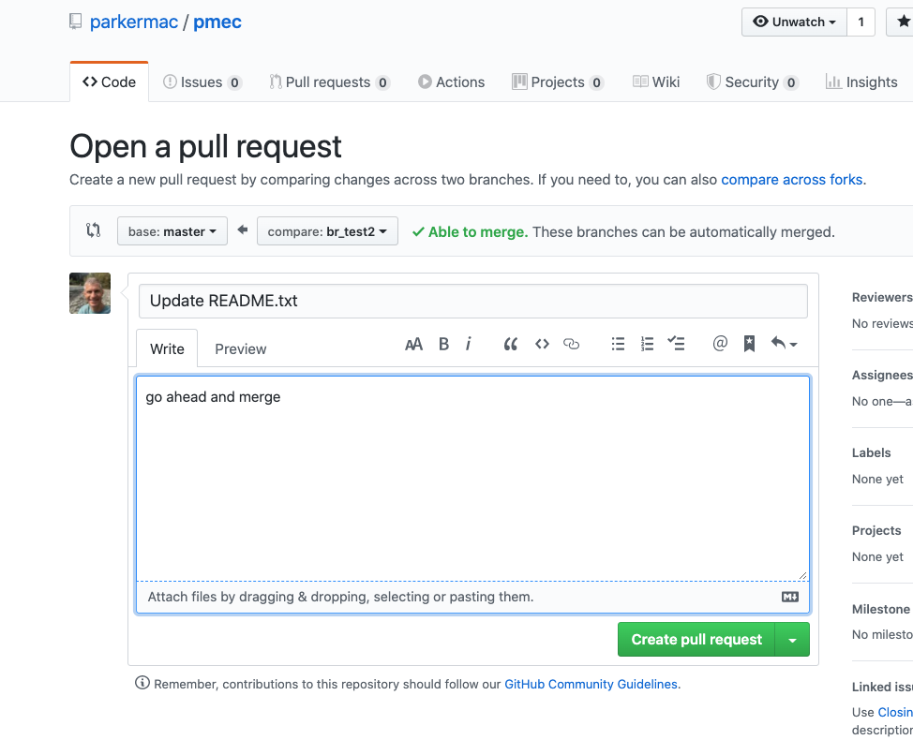
Then...
When you (collaborator) make the pull request in GHD it sends you to GitHub in the cloud to make the actual request.

Slide 8
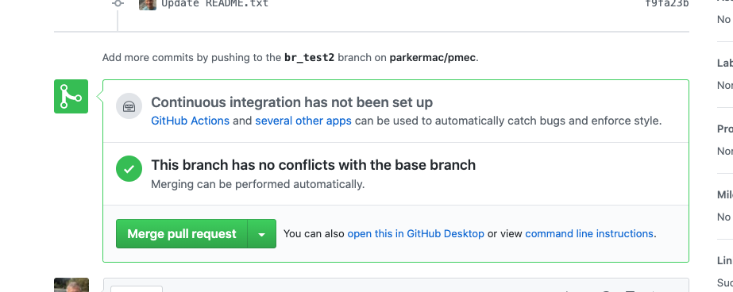
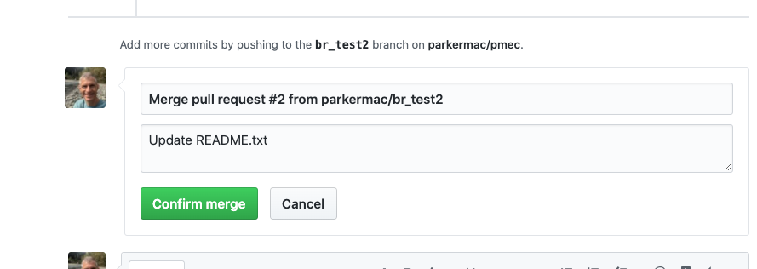
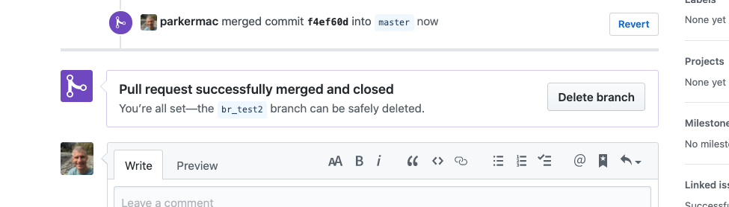
Then...
Leader goes to GitHub, and decides if the changes in the branch should be merged with master.

Slide 9
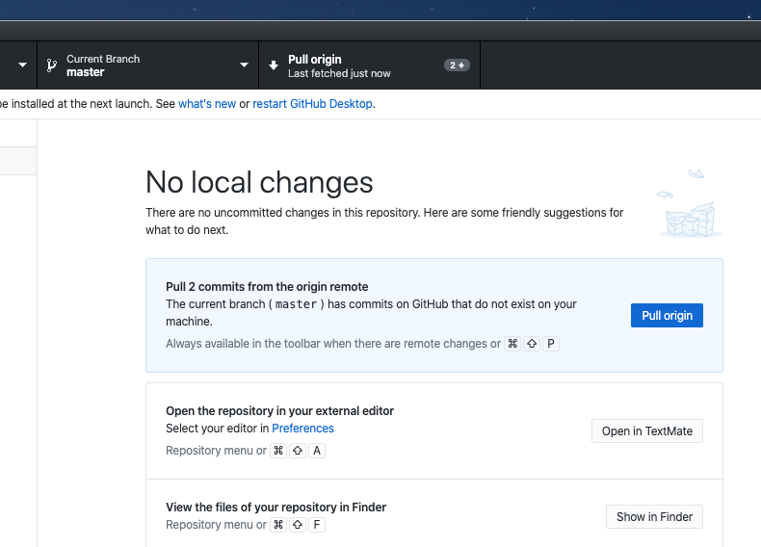
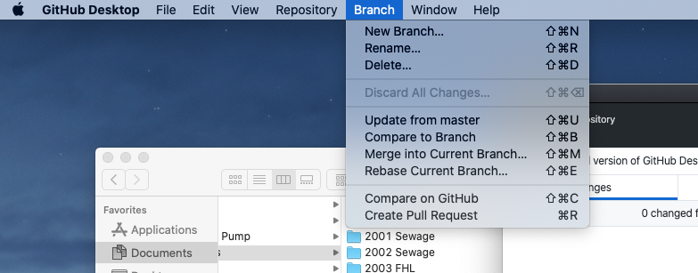
Then...
Leader will have to "pull origin" on their laptop to get the edits reflected there.
In general GHD will prompt you for the next logical step.
It is easy to delete branches to clean up after you are done

